Slide 1

We will be live sooon!!

Slide 2


“Python Fundamentals”
PDSC Workshop. Day 1
Huge thanks to @regmicmahesh for help with the slides.

Slide 3








Who am I ?
Website: https://www.awebisam.com
Email: hello@awebisam.com
Facebook: https://facebook.com/awebisam
Twitter: https://twitter.com/awebisam
Linkedin: https://linkedin.com/in/awebisam
Aashish Bhandari Former Software Engineer and CTO @Lanceme Up

Slide 4
What to Expect
A kick-start into your programming journey.
Fundamental concepts of the language.
Basic Understanding of Workflow and Execution Flow.
Hands-On Programming in Python.
Answer of your questions related to python and technology in general.

Slide 5
What not to Expect
Learning without doing yourself.
You are getting hired after this workshop.
Your instructor to know everything.

Slide 6
What do we expect from you
Strong passion towards programming.
Working and good internet connection.

Slide 7

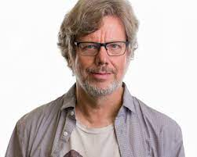
What is Python?
Doesn’t have specific purpose
executed line-by-line
General purpose , interpreted open source programming language.
Source code is public.
Guido Van Rossum (Creator of Python)

Slide 8
What is Python Used In?
Web Applications
Scripting and Automation
AI/ML
Prototyping.
Quickly build scalable web applications with lots of libraries and framework to support your development.
General purpose users and system administrators can write scripts to automate different tasks.
Intensively used in machine learning and artificial intelligence with new frameworks emerging each day.
Large organizations use python for rapid prototyping and implement their product in lower level language later on.
1
2
3
4

Slide 9
Code Execution Model
Source Code
Byte Code
Execution
A a file with extension .py with correct syntax and no errors.
The source code is converted into bytecode (pyc) by the `python compiler`.
The code is then executed by python virtual machine.

Slide 10
Let’s set up our environment

Slide 11
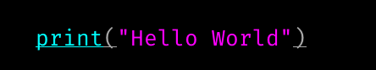
Simple hello world program.
print() function prints the given value into the console
Text should always be quoted inside “ “.

Slide 12
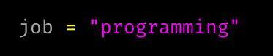
Variables
Imagine needing to type the value of PI upto 10 digits everytime you need to use it’s value in a program.
Instead, we save in variable.
Names given to store the value we use throughout the program
variable name
value

Slide 13
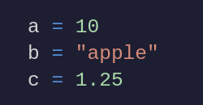
Data Types
We give the variable a type so the computer
can do the operations we perform.
this is integer type.
this is a string.
string is just a bunch of text.
this is floating point number.

Slide 14
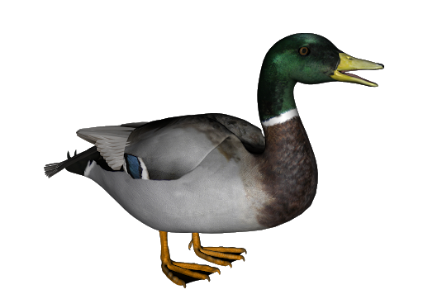
Wait how does python know the data type whether they are integer or float or string?
Duck Typing
If it looks like a duck, swims like a quick and quacks like a duck, it is probably a duck.
Let me show you what I mean in next slide.

Slide 15
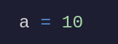
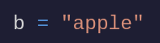
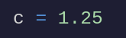
every number you type without enclosing in quotes as “10” and has no decimal point is integer.
It also includes negative numbers. Any number between negative infinity to positive infinity counts.
anything you enclose in quotes is a string.
similar as integer but has decimal point.

Slide 16
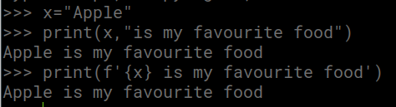
Formatting with fstring
We can print like this
Or fstring allows us to write variables inside string.

Slide 17
Checking data type of a variable.
type(value)
If you pass a variable, remember it’s replaced with its value. Because variable as just name given to values we store in memory.

Slide 18
How does this execute?
Ok i see you’re saving 3 in a variable named a.
Hmm, I see your value like integer.
Ok, a stores a value of integer 3 DONE a = 3.
a = 3 b = type(a) print(b)
Ok, you’re calling the function type with value ‘a’, which returns the type of variable. Oh, also you’re saving it in b. DONE b = int
Ok printing b.
OUTPUT: <class ‘int’>

Slide 19
What can be a variable name?
A variable name must start with _ or any alphabet.
It can contain any digits or alphabets and can be of any length.
It cannot have whitespace in middle.

Slide 20
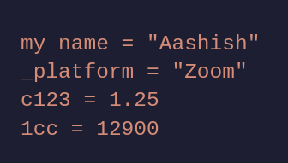
Are these variable names valid?

Slide 21
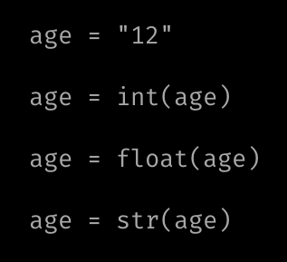
Converting data type
Here, age is a string value.
Now age is converted to int.
Now age is converted to float.
Now age is converted to str.

Slide 22
Arithmetic Operators [ for int and float ]
+
-
*
**
addition
subtraction
multiplication
power
/
division
%
//
remainder
quotient

Slide 23
Performing arithmetic operation.
a = 3 + 3 - 16 * 5
operator
Every arithmetic operation follows BODMAS rule.

Slide 24
Implicit Casting in Python
If a operation is performed between float and int, the result is always float.
The result of division operator is always float.

Slide 25
Some arithmetics for strings.
I am not kidding.
+
*
addition
multiplication
result = “one” + “another”
print(result) OUTPUT: “oneanother”
result = “one” * 3 print(result) OUTPUT: “oneoneone”

Slide 26
Comparison Operators.

Slide 27
Comparison Operators.
Because when we compare two value in python.
The result of comparison is either true or false.
Let’s learn a new data type called boolean.
True
False
It’s like binary. It’s either 0 or 1.
It’s like gender, male or female.
In python, it’s represented as true or false.

Slide 28
Comparison Operators [ for int and float ]
<
>
==
<=
Less than
Greater than
equals
Less than or equal to
>=
!=
in
not
greater than or equal to
Not equals
In a string?
Invert a boolean.

Slide 29
Comparison of string is in alphabetical order.
Comparison of numbers is mathematical.

Slide 30
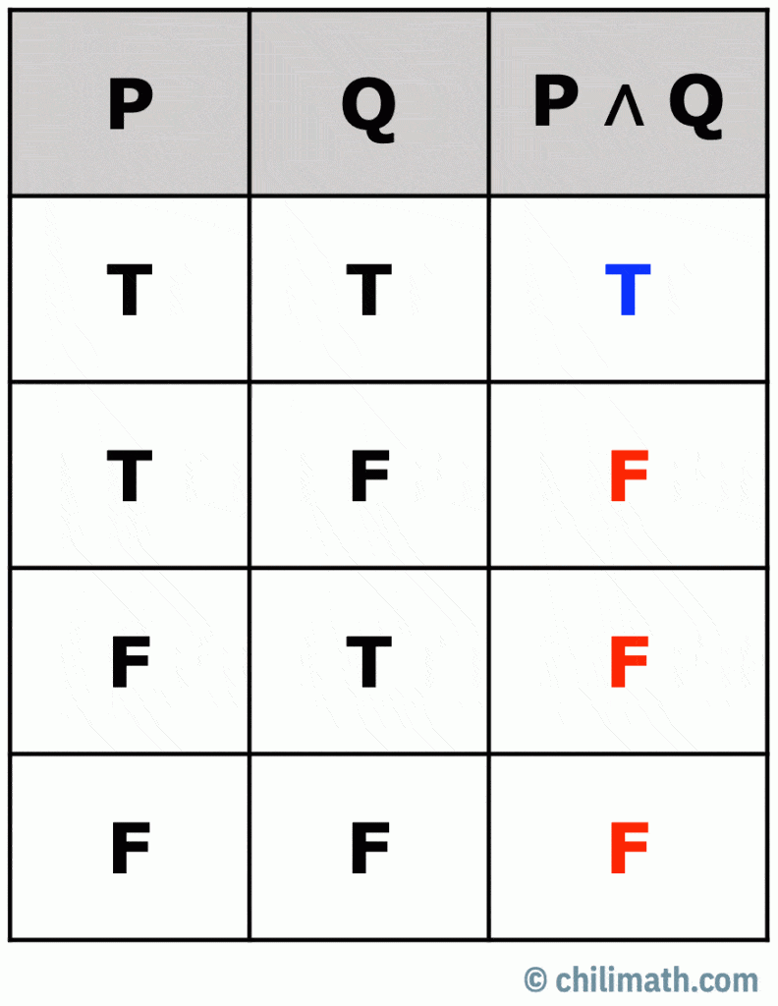
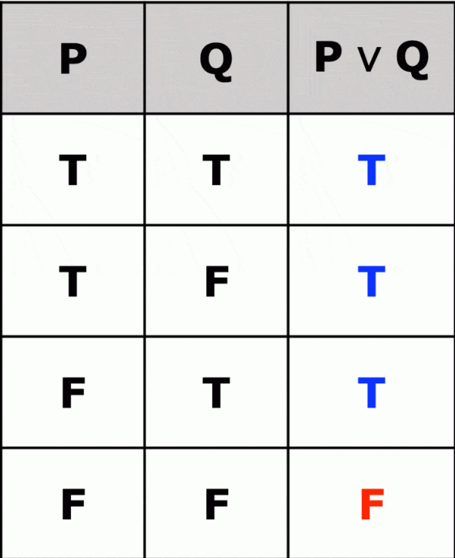
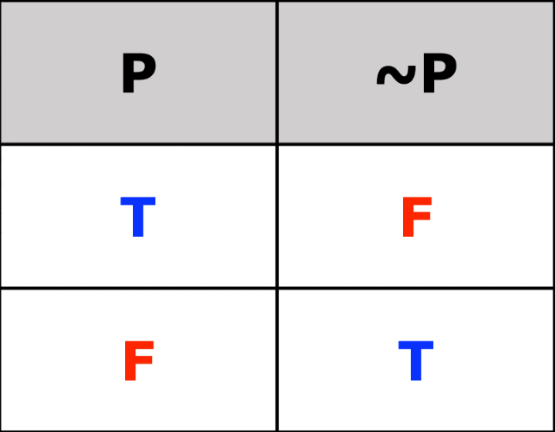
Logical Operators
and
or
not
True if and only if both of the operands are true.
True if either of operand is true.
Takes only one operand and inverts it.

Slide 31
Practice Quiz
2 < 3 and 5 < 6
2 == 2 or “a” = “b”
5 >= 5 and 6 >= 6
True or False
not True

Slide 32
Taking Input from User
input(“Enter value”)
The value returned by this function is always string.
Message for the user so they knows what this input is for.

Slide 33
Let’s get deeper with string.
A string can be quoted with either “ or ‘ or “””.
a = “abisam”
begins at 0
Index | 0 | 1 | 2 | 3 | 4 | 5
Value | a | b | i | s | a | m

Slide 34
Extracting a single character from a string.
Index | 0 | 1 | 2 | 3 | 4 | 5
Value | a | b | i | s | a | m
a = “abisam”
second_char = a[2]
print(second_char)
OUTPUT: i

Slide 35
Slicing a string.
Extract substring from a string.
2
7
index | 0 | 1 | 2 | 3 | 4 | 5 | 6
value | a | a | s | h | i | s | h
a = “aashish”
second_char = a[2:7]
print(second_char)
OUTPUT: shish

Slide 36
Slicing a string [another example]
Extract substring from a string.
index | 0 | 1 | 2 | 3 | 4 | 5 | 6 | 7 | 8 | 9 | 10
value | h | e | l | l | o |  | w | o | r | l | d
a = “hello world”
second_char = a[3:8]
print(second_char)
OUTPUT: lo wo

Slide 37
Some common string methods/functions.
lower upper
replace
Convert string to lowercase.
Convert string to uppercase.
Replace certain portion of string with another.

Slide 38
Let’s see sequences.

Slide 39
Lists

Slide 40
List
List is a flexible container data type.
myList = [“mahesh”, “aashish” , “yaman”]
index | 0 | 1 | 2
value | mahesh | aashish | yaman

Slide 41
Extracting a single item from a list.
index | 0 | 1 | 2
value | mahesh | aashish | yaman
myList = [“mahesh”, “aashish” , “yaman”]
print(myList[1])
OUTPUT: aashish

Slide 42
List can store any type of value.
myList = [“mahesh” , 1 , True, 3.14 ]
index | 0 | 1 | 2 | 3
value | “mahesh” | 1 | True | 3.14
type | str | int | boolean | float

Slide 43
Slicing a list
Extract certain items from a list.
index | 0 | 1 | 2 | 3
value | “mahesh” | 1 | True | 3.14
type | str | int | boolean | float
myList = [“mahesh”, “aashish” , “yaman”]
print(myList[1:3])
OUTPUT: [1 boolean]

Slide 44
Inserting and Removing value in a list.
myList = [“mahesh”]
myList.append(“aashish”)
myList.remove(“aashish”)
[“mahesh”]
[“mahesh” , “aashish”]
[“mahesh”]

Slide 45
Sorting list was never this easy!
a = [5 , 13 , 65 , 0, -1] a.sort() print(a) OUTPUT: [-1, 0, 5 , 13 , 65]

Slide 46
There are two similar data types to list.
Tuple and Set
Tuple is almost same as List but we can’t change tuple i.e adding and removing items is not allowed. We use parentheses for a tuple. Like tpl=(“aashish”, “Mahesh”)
Set is unordered collection where repetition is not allowed. We use curly brackets for a set. Like st = {“awebisam”, “bhandari”}

Slide 47
Set
Remember those sets in maths?
creating a set.
Rules of set
Cannot contain duplicate (unique values only)
Union, Intersection, Difference are defined.
a = { 1 , 2, 10, 15 , 2 , 5 }
Same with Python !

Slide 48
Set automatically remove duplicate items!
items = {12, 14, 13, 12, “a”, “a” , “b” }
But items will be equal to {12 , 14 , 13 , “a” , “b” }

Slide 49
Adding/Removing items to set.
items = {12, 14, 13, 12, “a”, “a” , “b” }
items.add(12)
Won’t add duplicate item, won’t throw error either.
items.add(“aashish”)
Will surely add items.
items.remove(“aashish”)
This will remove “aashish” from the set.

Slide 50
But list had append why add here?
In computing, append means to insert a item at end.
In set, there is no concept of indexing.
items = {12, 15 , 16, 20}
print(items[0])
ERROR!

Slide 51
Some Fundamental Operations of Set
Union ( & )
Intersection ( | )
Difference ( - )

Slide 52
You can convert list to set and vice versa.
items = {15, 16, 20}
items = list(items)
items = set(items)
This is a set.
This is a list now.
This is again set now.

Slide 53
A quick use!
Removing duplicate items from list.
names = [“aashish”, “mahesh”, “aashish”] names = list(set(names))

Slide 54
Dictionary
Key | Value
university | Trivuwan University
location | Kathmandu
established | 1991
How can we store this?
university = “Trivuwan University”
location = “Kathmandu”
established = 1991
Not bad.
But what if I want to store data of 5 colleges? Or even 50?

Slide 55
university = “Trivuwan University”
location = “Kathmandu”
established = 1991 university2 = “Duke University”
location2 = “Ratnapark”
established2 = 1991
university3 = “Charles Darwin University”
location3 = “Thamel”
established3 = 1970
university4 = “Stanford University”
location4 = “Jhapa”
established4 = 1936
university5 = “Harvard University”
location5 = “Pulchowk”
established5 = 1934
Hell, lot of variables.
Can we refactor it?
university = {
“name” : “Trivuwan University”,
“location”: “Kathmandu”,
“established” : 1991 }
key
:
value

Slide 56
dictionary
university = {
“name” : “Trivuwan University”,
“location”: “Kathmandu”,
“established” : 1991 }
A dictionary stores value in the form of key and value.

Slide 57
Accessing and inserting value in a dict.
university = {
“name” : “Trivuwan University”,
“location”: “Kathmandu”,
“established” : 1991 }
print(university[“name”])
university[“isNepali”] = True
Accessing
Modifying / Adding

Slide 58
Removing value from dictionary.
university = {
“name” : “Trivuwan University”,
“location”: “Kathmandu”,
“established” : 1991 }
del university[“location”]

Slide 59



Slide 60
Conditionals

Slide 61
If Statement
if day == “saturday”:
Always ends with :
Condition (evaluates to a boolean value)

Slide 62
Space is evil!
day = “saturday”
if day == “saturday”:
print(“Ghar ma basne aaja”)
print(“Aru kam ta xadai xa”)
Remember these spaces.

Slide 63
If-Else Statement
Syntax
if <condition>: <statement to run> <statement to run> else: <statement to run> <statement to run>
day = “saturday”
if day == “saturday”:
print(“Ghar ma basne aaja”)
else :
print(“college jane”)
print(“bhat khane”)
Notice the highlighted code?
Those code run only when the condition of if statement is false.

Slide 64
Space is evil again!
day = “saturday”
if day == “saturday”:
print(“Ghar ma basne aaja”)
else:
print(“College janu paryo”)
print(“Khaana khaanu paryo”)
Remember these spaces.

Slide 65
If-Elif-Else Statement
Syntax
if <condition>: <statement to run> <statement to run> elif <condition>: <statement to run> else: <statement to run> <statement to run>
day = “saturday”
if day == “saturday”:
print(“Ghar ma basne aaja”) elif day == “friday”: print(“voli ta bida ho”)
else:
print(“college jane”)
print(“bhat khane”)
Notice the highlighted code?
Those code run only when the condition of if statement is false. Those code check if the condition of elif statement is true. The else block will run if the elif block also is false.

Slide 66
Space is evil again again!
day = “saturday”
if day == “saturday”:
print(“Ghar ma basne aaja”)
print(“Nuhauna parxa”)
print(“school xutti”)
elif day == “friday”:
print(“aaja half xutti”)
else:
print(“school janu paryo”)
print(“khaana khaanu paryo”)
Remember these spaces.

Slide 67
Note
Elif and else are optional!

Slide 68
Imagine a scenario.
You have a list of numbers.
nums = [1, 2, 3, 4, 5]
print(nums[0] ** 2)
print(nums[1] ** 2)
print(nums[2] ** 2)
print(nums[3] ** 2)
print(nums[4] ** 2)
You want to display square of each numbers.
Isn’t this ugly already?
We’re repeating so much of code.

Slide 69
Looping
When you need to do a certain task repeatedly.
nums = [1, 2, 3, 4, 5]
How to square and print all items in the list?
for i in items:
print(i ** 2)

Slide 70
Demystifying the syntax.
Write in after the variable name.
for i in listName:
write for in the beginning.
There should be a iterable here
(list / string / generator)
print(i ** 2)
separated by space.
This block of code will run for every value in the iteration.

Slide 71
Looping over range.
Range is a value generator.
for i in range(10):
print(i)
range(start=0, stop, step=1)
If you pass only one value start = 0
stop = yourValue
step = 1
Example: range(20)
If you pass two values.
Start = yourValue
Stop = yourValue
Step = 1
Example: range(10,20)
If you pass three values.
Start = yourValue
Stop = yourValue
Step = yourValue
Example: range(0,20,5)

Slide 72
Some examples
start = 0
stop = 5
step = 1
start = 5
stop = 10
step = 1
start = 1
stop = 10
step = 2
CODE
for i in range(5):
print(i)
for i in range(5,10):
print(i)
for i in range(1,10,2):
print(i)
OUTPUT
0
1
2
3
4
5
6
7
8
9
1
3
5
7
9

Slide 73
While Loop.
while <condition>:
<statement>
<statement>
These statement will run till the condition evaluates to true.

Slide 74
while True:
print(“I will run forever”)
this will run forever.
this will never run.
while False:
print(“I will run forever”)
i = 0 while i < 5:
print(“i will run 5 times”)
i += 1
this will run 5 times.

Slide 75
Function
Do you remember those functions in math?
f(x) = 3x + 5
function logic / body
input of the function

Slide 76
What is the value of f(3) ?
f(x) = 3x + 5 f(3) = 3 * 3 + 5 f(3) = 14
The value returned by the function.

Slide 77
Let’s write this in python.
We write def to let python know we’re making a function.
def f(x):
result = 3 * x + 5
return result
f(x) = 3x + 5

Slide 78
But why do we need function?
Suppose you need to calculate the area of circle in your program.
Instead of repeating code, we make a function to do our task.
def area(r):
result = 3.1415 * (r ** 2)
return result

Slide 79
Now we can call the function any number of times and get our desired value.
print(area(5))
print(area(10))
print(area(15))
OUTPUT
78.54
314.15
706.84
How simple is that?

Slide 80
A function to greet you!
Remember, this function doesn’t return anything.
It just prints using the parameter.
def greeting(name): print(“Welcome” + name)
greeting(“aashish”)
OUTPUT: Welcome aashish
defining a function
Invoking a function.
Result of function.

Slide 81
So, let’s formalize a python function.
You’ll call the function with this name.
This is also optional.
But the brackets are not!
def <functionName>(<arguments>): <functionBody> return <value>
A function should have some body.
This is optional.
If a function doesn’t return any value.
It’s return value is None.

Slide 82
Function which takes no argument!
def get_username(): text = input(“Enter your name: ”) return text
your_name = get_username()

Slide 83
Working with multiple files!
Remember you don’t include extension here.
main.py
import data print(data.usernames) print(data.usernames[1]) print(info) data.printMe()
data.py
usernames = [“admin” , “mahesh”, “aashish”] Info = “Ecommerce Website”
def printMe(): print(“from printMe”, info)
Everytime you need to use something from that imported stuff.
Just insert dot after the filename.

Slide 84
Multiple ways to import.
module
Notice here, you import what you need only.
main.py
from data import usernames, info print(usernames) print(usernames[1]) print(info)
data.py
usernames = [“admin” , “mahesh”, “aashish”] Info = “Ecommerce Website”
def printMe(): print(“from printMe”, info)
You cannot use printMe here, because you haven’t imported that!

Slide 85

Thank You
Hope to see you tomorrow.

Slide 86
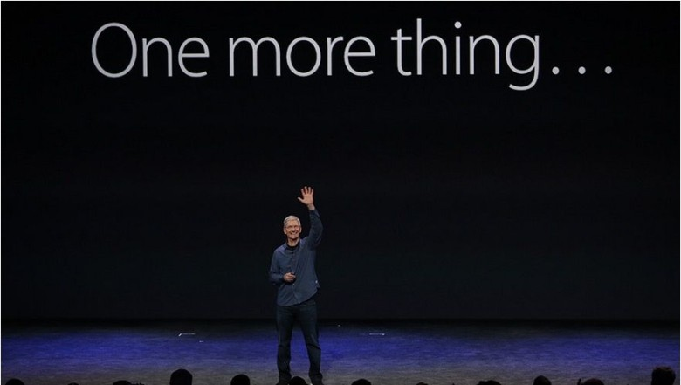

Slide 87
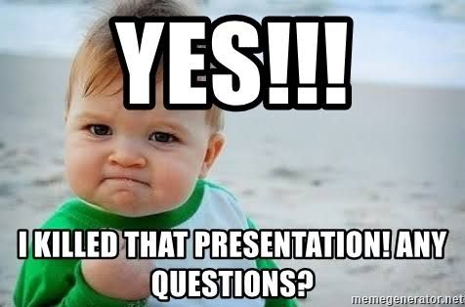

Slide 88
Find me here:
Website: https://www.awebisam.com
Email: hello@awebisam.com OR me@awebisam.com
Facebook: https://facebook.com/awebisam
Twitter: https://twitter.com/awebisam
Instagram: https://instagram.com/awebisam
Linkedin: https://linkedin.com/in/awebisam

